Slide 1
http://www.vidyanidhi.com/
ketkiacharya.net@gmail.com
Ketki Acharya
From: SM VITA ATC of CDAC
9769201036
ketkiacharya.net@gmail.com

Slide 2
What is a REST API?
Due to the increasing number of different varieties of clients (mobile apps, browser-based SPAs, desktop apps, IOT apps, etc.), we need better ways for transferring data from servers to clients, independent of technology and server stacks.
REST APIs solve this problem. REST stands for representational state transfer. REST APIs are HTTP-based and provide applications the ability to communicate using lightweight JSON format. They run on web servers.
REST consists of the following entities:
Resource: Resources are uniquely identifiable entities (for example: data from a database, images, or any data).
Endpoint: A resource can be accessed through a URL identifier.
HTTP method: HTTP method is the type of request a client sends to a server. GET POST PUT DELETE
HTTP header: An HTTP header is a key-value pair used to share additional information between a client and server, such as:
Type of data being sent to server (JSON, XML).
Type of encryption supported by client.
Authentication-related token.
Customer data based on application need.
Data format: JSON is a common format to send and receive data through REST APIs.

Slide 3
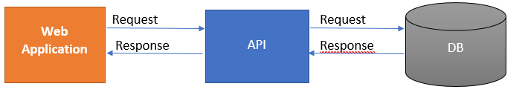
What is Web API?
Why Web Api required?
How to create Asp.net Core web API using .Net 7.
What is Web API?
API stands for Application Programming Interface. It is an intermediate software agent that allows two or more applications to interact with each other.
In simple words, we can say that a web API is an application programming interface for a web application or web server. It uses HTTP protocol to communicate between clients and websites to have data access.
Asp.net Core web API is a cross-platform web API.

Slide 4
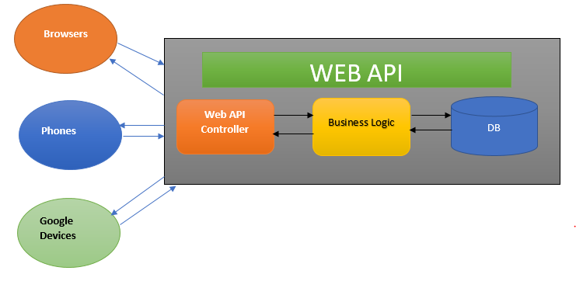
Why is Web API required?
The user wants to access the application from different devices like mobile, browser, Google devices, etc. In this case, Web API can be useful.
Different devices request to Web API and Web API will respond in JSON format. Most of the devices are able to understand JSON output.
Let’s see the below web Api Architecture diagram,
This diagram explains the architecture of Web API.
A client called api/controller – In the above diagram Browers, Phones, and Google Devices are called Web API Controllers.
api/Controller interact with business layer and get Data from DB.
The output will be returned in JSON format.
This is very basic Web API.

Slide 5
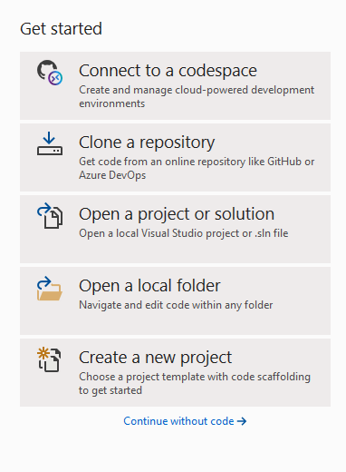
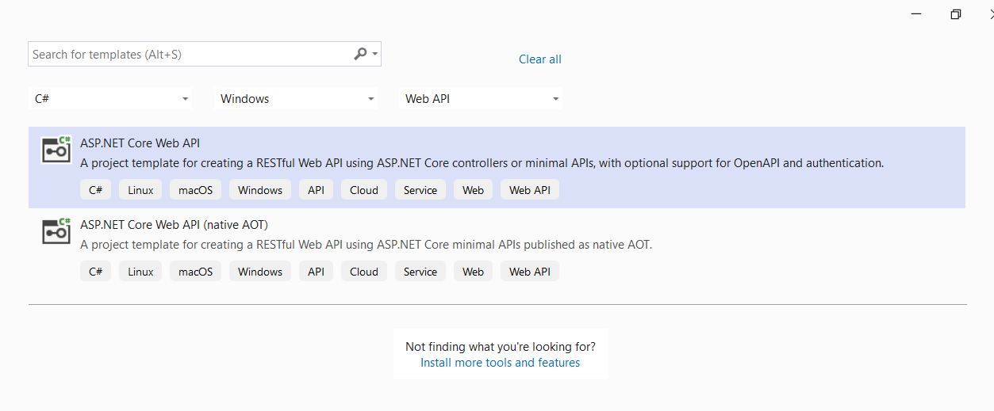
How to create an Asp.Net core web API
We will create our first simple Web API using Visual Studio 2022. You can download the free community version from the Microsoft official site.
Follow the below steps to create your first Web API project,
Open Visual Studio 2012 and create a new project.

Slide 6
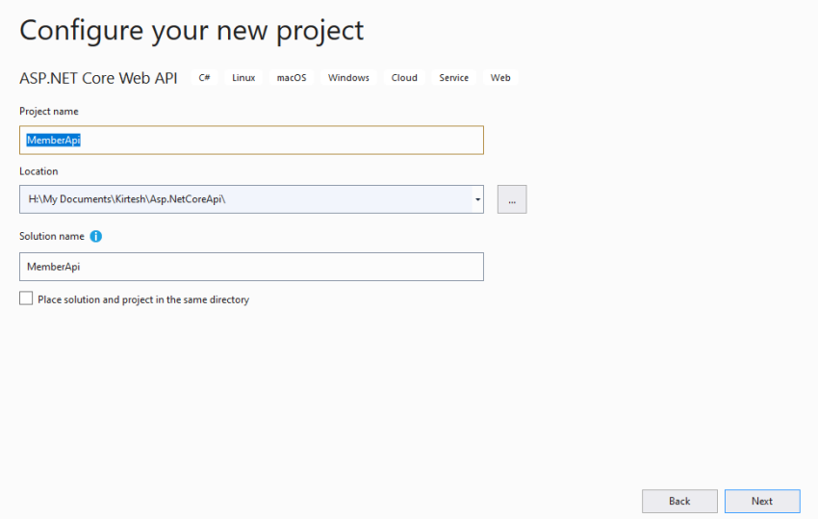
Provide Project name and location.
Select Target Framework and click on Create button.

Slide 7
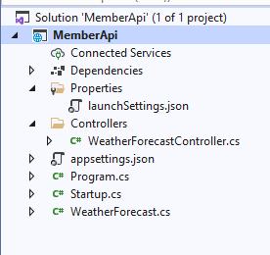
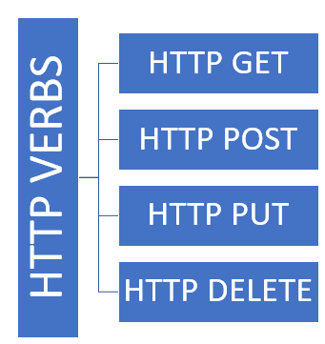
Member API is created. See below project structure.
Web API is mostly used for CRUD (Create, Read, Update, DELETE) operations. It follows HTTP verbs for these operations.
HTTP GET – Read Operation
HTTP POST – Create Operation
HTTP PUT – Update Operation
HTTP DELETE – Delete Operation

Slide 8
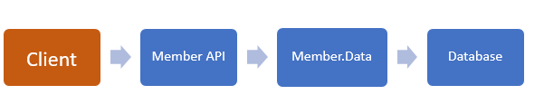
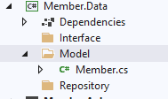
Following Diagram will explain our project which we are going to create
First, we will create Member Data Layer and then create Member API Controller.
Step 1
Create New .Net Class Library Called Member. Data
Step 2
Add three Folders; Models, Interface, and Repository in Member. Data Class library.

Slide 9
Step 3
In the model folder, create a Model Class called member.
public interface IMembers
{
List<Members> GetAllMember();
Members GetMember(int id);
Members Add(Members employee);
Members Update(int id, Members MembersChanges);
Members Delete(int Id);
public class Members
{
public int MemberId { get; set; }
public string FirstName { get; set; }
public string LastName { get; set; }
public string Address { get; set; }
}
In program.cs file don’t forget to add this line
builder.Services.AddScoped<IMembers, MembersRepository>();

Slide 10
public class MembersRepository : IMembers
{
static List<Members> lisMembers = new List<Members>
{
new Members{MemberId=1, FirstName="Kirtesh", LastName="Shah", Address=“Mumbai" },
new Members{MemberId=2, FirstName="Nitya", LastName="Shah", Address="Vadodara" },
new Members{MemberId=3, FirstName="Dilip", LastName="Shah", Address=“Banglore" },
new Members{MemberId=4, FirstName="Atul", LastName="Shah", Address=“Indore" },
new Members{MemberId=5, FirstName="Swati", LastName="Shah", Address=“Mumbai" },
new Members{MemberId=6, FirstName="Rashmi", LastName="Shah", Address=“Ahamdabad" },
};
public List<Members> GetAllMember()
{
return lisMembers;
}
public Members GetMember(int id)
{
return lisMembers.FirstOrDefault(x => x.MemberId == id);
}
public Members Add(Members member)
{
member.MemberId = lisMembers.Max(e => e.MemberId) + 1;
lisMembers.Add(member);
return member;
}
public Members Delete(int Id)
{
Members members = lisMembers.FirstOrDefault(e => e.MemberId == Id);
if (members != null)
{
lisMembers.Remove(members);
}
return members;
}
public Members Update(int id,Members memberChanges)
{
Members member = lisMembers.FirstOrDefault(e => e.MemberId == memberChanges.MemberId);
if (member != null)
{
member.FirstName = memberChanges.FirstName;
member.LastName = memberChanges.LastName;
member.Address = memberChanges.Address;
}
return member;
}
}

Slide 11
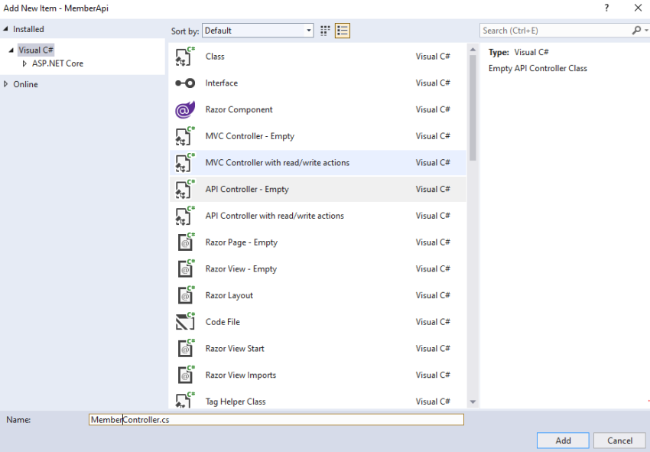
Step 7
Now we will create MembeApi Controller in the Controller folder. Right-click on the Controller folder and Click on Add-Controller

Slide 12
Get | Url/hyperlink [HttpGet] | Api/member
Get(int id) | Url/hyperlink [HttpGet(“{id}”)] | Api/member/1
Post([FromBody] member) | [HttpPost]➔Add | Api/member ➔frombody Raw➔ json
Delete(int id) | [HttpDelete]➔delete | Api/member/1➔URL
Put(id , [FromBody]member) | [HttpPut]➔Update | Api/member/1➔Url Member➔From body

Slide 13
using Microsoft.AspNetCore.Mvc;
using System;
using System.Collections;
using System.Collections.Generic;
using WebAPI.Models;
// For more information on enabling Web API for empty projects, visit https://go.microsoft.com/fwlink/?LinkID=397860
namespace WebAPI.Controllers
{
[Route("api/[controller]")]
[ApiController]
public class MemberController : ControllerBase
{ private readonly IMembers member;
public MemberController(IMembers mem)
{
member = mem;
}
// GET: api/<MemberController>
[HttpGet]
public IEnumerable<Members> Get()
{
return member.GetAllMember();
}
// GET api/<MemberController>/5
[HttpGet("{id}")]
public Members Get(int id)
{
return member.GetMember(id);
}
// POST api/<MemberController>
[HttpPost]
public Members Post([FromBody] Members memberpost)
{
return member.Add(memberpost);
}
// PUT api/<MemberController>/5
[HttpPut("{id}")]
public Members Put(int id, [FromBody] Members memberput)
{
return member.Update(id,memberput);
}
// DELETE api/<MemberController>/5
[HttpDelete("{id}")]
public void Delete(int id)
{
member.Delete(id);
}
}
}

Slide 14
What if I have two method with same format
http://localhost:5171/api/Member/1
http://localhost:5171/api/Member/Atul
http://localhost:5171/api/Member/Address/Mumbai
[HttpGet("Address/{address}")]
public IEnumerable<Members> GetAddress(string address)
{
return member.GetAllMemberbyaddress(address);
}
// GET api/<MemberController>/5
[HttpGet("{id:int}")]
public Members Get(int id)
{
return member.GetMember (id);
}
[HttpGet("{name}")]
public IEnumerable<Members> Get(string name)
{
return member.GetAllMemberbyname(name);
}
Observe data type is mentioned here
Other wise you get
Add method definition in service class
public List<Members> GetAllMemberbyname(string name)
{
return lisMembers.FindAll((nm)=>nm.FirstName ==name);
}
public List<Members> GetAllMemberbyaddress(string address)
{
return lisMembers.FindAll((nm) => nm.Address == address);
}
Add method in interface
public interface IMembers
{
List<Members> GetAllMember();
Members GetMember(int id);
List<Members> GetAllMemberbyname(string name);
List<Members> GetAllMemberbyaddress(string address);
Members Add(Members employee);
Members Update(int id, Members MembersChanges);
Members Delete(int Id);
}

Slide 15
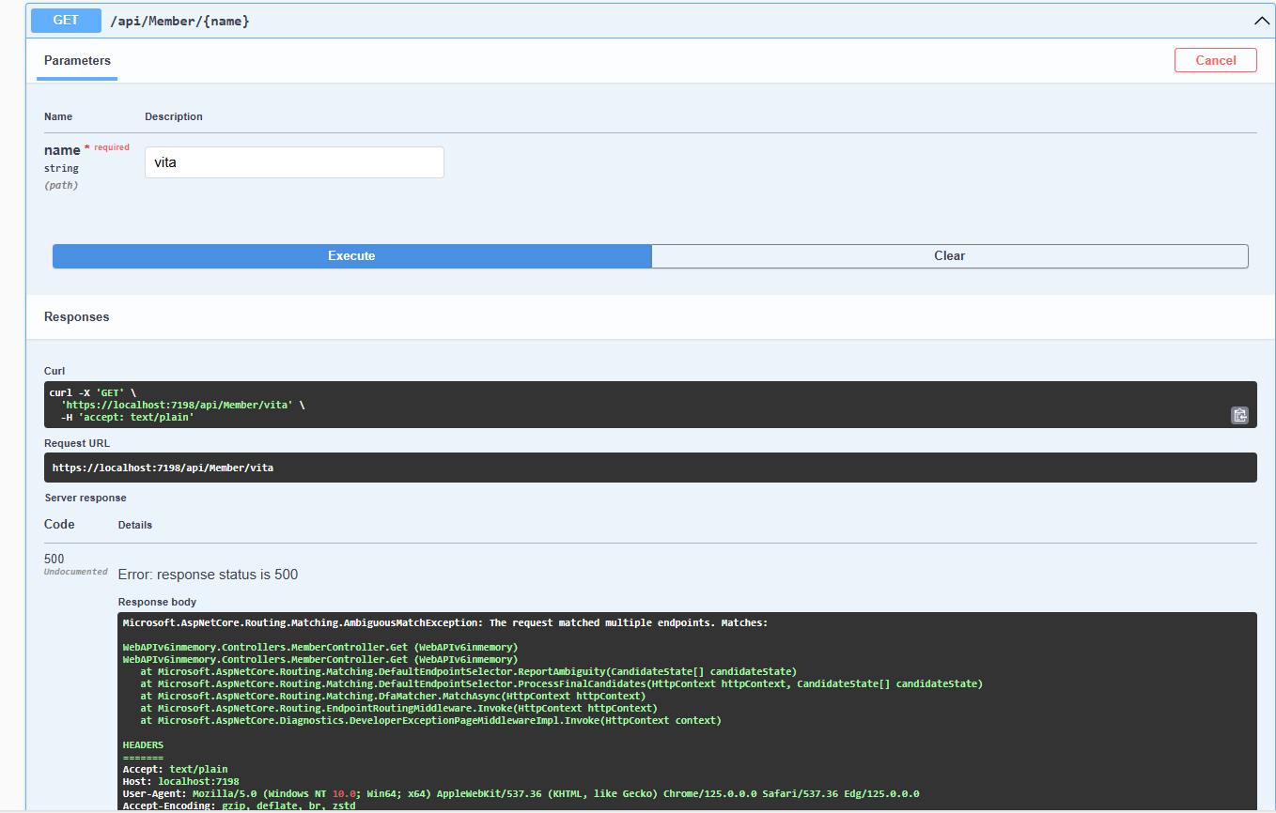

Slide 16
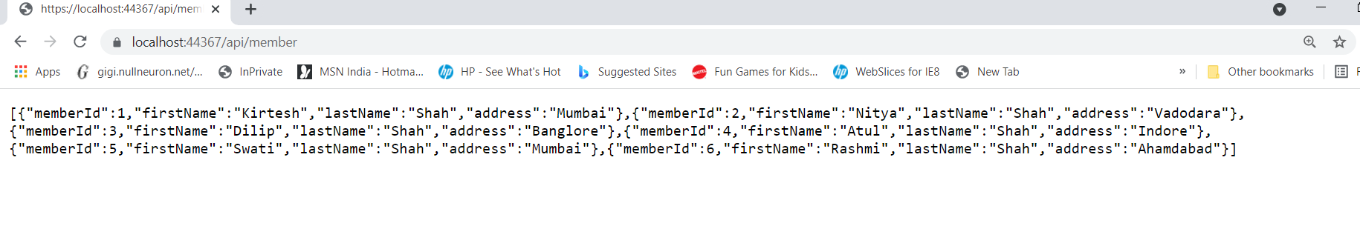
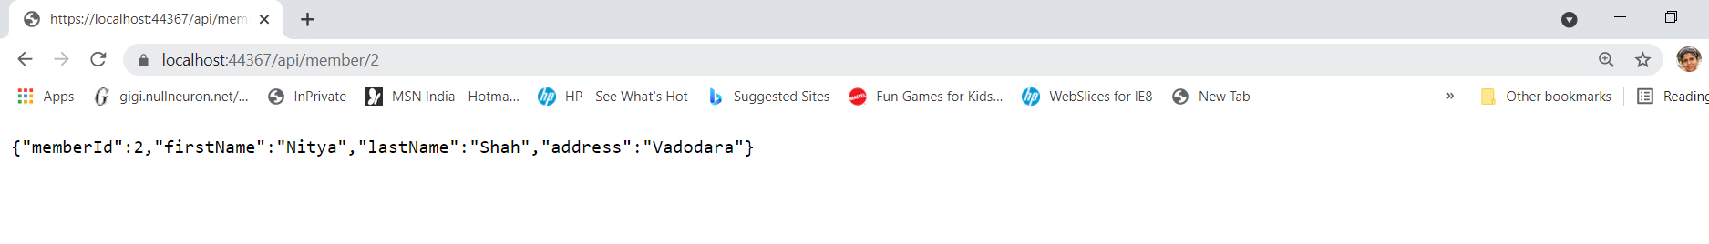

Slide 17
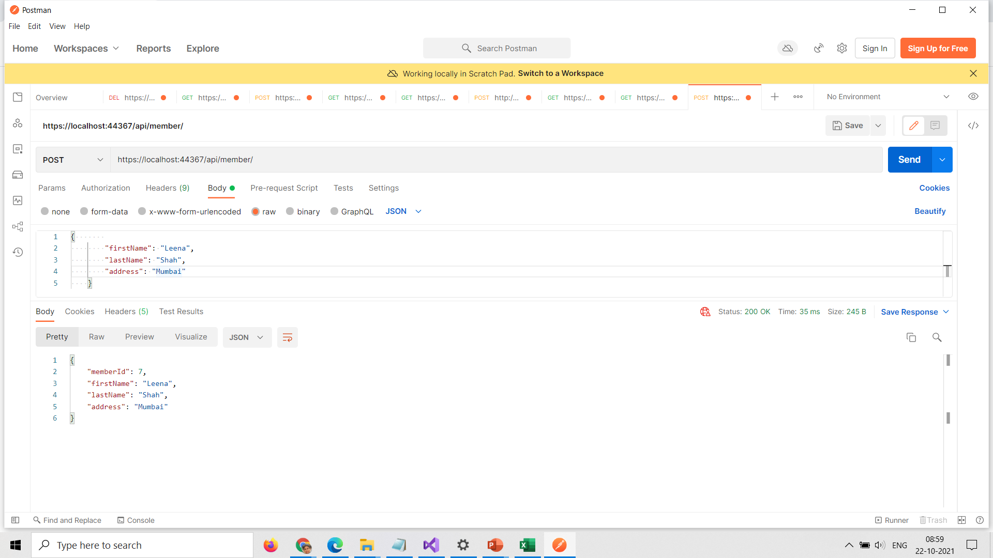

Slide 18
[ApiController]
Attribute routing
Attribute routing will be required if you use [ApiController], eg:
[ApiController]
[Route("[controller]")]
public class DataTablesController: ControllerBase
Actions are inaccessible via conventional routes defined by UseEndpoints, UseMvc, or UseMvcWithDefaultRoute in Startup.Configure
Automatic Http 400 responses
Adds an action filter to return 400 response if the ModelState fails validation. You no longer need to write this in your actions, it will be handled automatically:
if (!ModelState.IsValid)
{
return BadRequest(ModelState);
}
The [ApiController] attribute can be applied to a controller class to enable the following opinionated, API-specific behaviors:
Binding source parameter inference
A binding source attribute defines the location at which an action parameter's value is found. The following binding source attributes exist: [FromBody], [FromForm], [FromHeader], [FromQuery], [FromRoute], [FromServices]
Multipart/form-data request inference
The [ApiController] attribute applies an inference rule when an action parameter is annotated with the [FromForm] attribute. The multipart/form-data request content type is inferred.
An example using binding source parameter inference:
[HttpPost]
public IActionResult Test([FromForm] Model model)
{ return Ok("test");
}

Slide 19
